Slide 1
Pathophysiology
Of the respiratory system

Slide 2
Respiration
  Four distinct processes
    Pulmonary ventilation
    External respiration (gas exchange)
    Transport of gases
    Internal (cellular) respiration

Slide 3
Devided into
  Upper
  And
  Lower
    Respiratory tract
    (+cardiovascular system, etc)

Slide 4
Providing smell and speech
Warm, damp and clean air
Hairs,
mucous
pseudostratified ciliated columnar epithelium,
Lined with irritant receptors
Pharynx: crossing food/air
five tonsils
lingual
pharyngeal (adenoid)
Larynx (voice box)
(between pharynx and trachea)
epiglottis
+ oral cavity

Slide 5
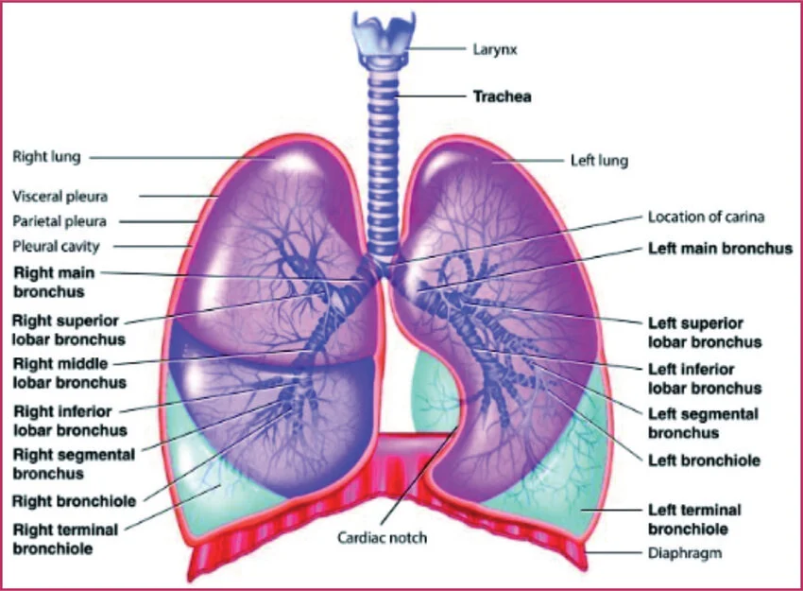
If any obstruction occurs
Above the Larynx,
Be it a foreign object,
Inflammation or trauma,
A hole or stoma may be created
In the trachea
And a small tube inserted.
This procedure is called a
Tracheostomy
And can ensure that the blocked
Portion of the upper airway is
Bypassed,
Enabling the patient to breath.

Slide 6
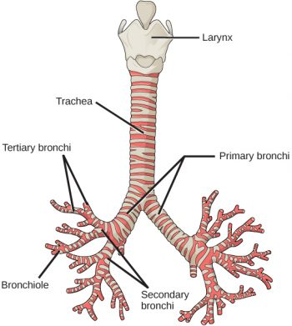
The airways terminate with numerous
Sphere-like structures
Called alveoli
Clustered together to form alveolar sacks
There are approximately
480 million alveoli
In the lungs.

Slide 7
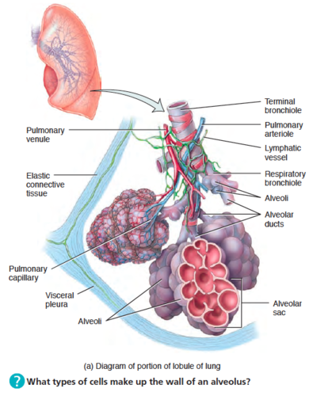

Slide 8
Pulmonary ventilation is actually breathing
Driven by pressure differences
Atmospheric pressure – „alveolar” pressure

Slide 9
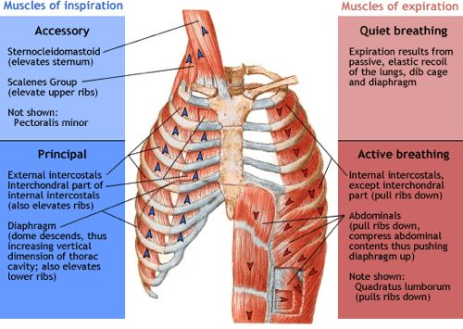

Slide 10
External respiration
„respiratory zone”
„anatomical dead space”
-- diffusion of respiratory gases between the alveoli and the pulmonary circulation (DIFFUSION)

Slide 11
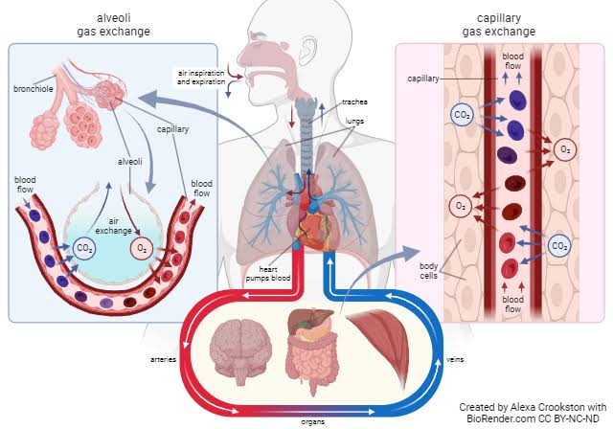

Slide 12
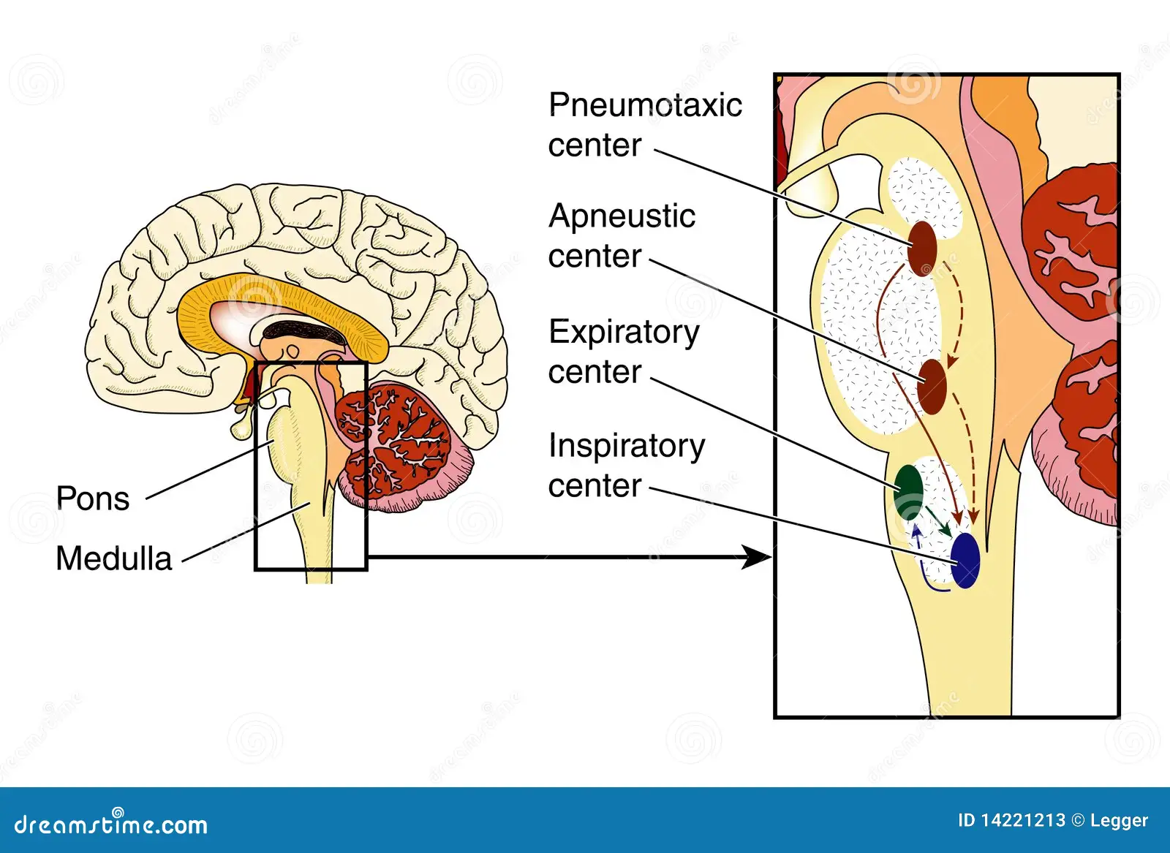
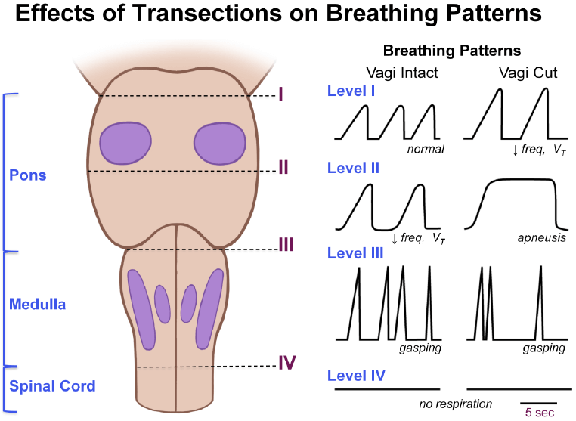

Slide 13
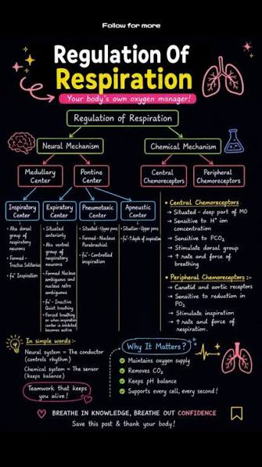
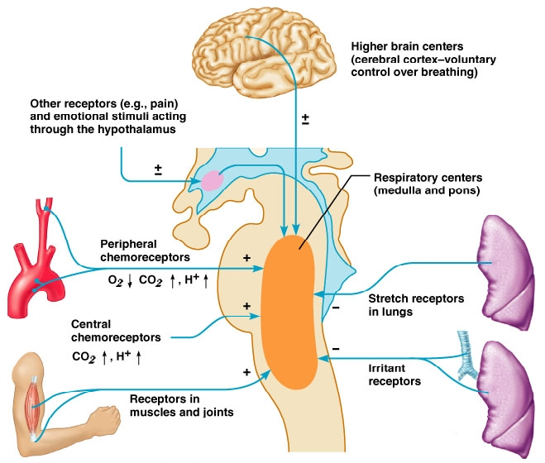

Slide 14
Eupnea | Normal breathing 12-16/min
Tachypnea | Rapid and shallow >20
Bradypnea | Slow <10
Hyperventilation | Increased ventilation
Hypoventilation | Decreased ventilation
Apnoea | Abscence of breathing >15 sec
Hypopnea | Shallow breathing w inadequate ventilation
Dyspnoea | Difficult or laboured breathing
Orthopnoea | Difficulty of breathing while lying flat
Cheyne-Stokes breathing | Irregular breathing cycles – drug overdoses, neurological disturbances, dying patient

Slide 15
Disorders of the respiratory system
Respiratory failure
  Respiration is unable to maintain the metabolic needs of the body
  (the lungs cannot „extract” enough oxygen from the atmosphere
  Saturation is supposed to be between 95-99% (SpO₂)
    Hb
    Pulsoxymeter
  Lower saturation in the arterie – hypoxemia
  Central cyanosis
  Naturally leads to hypoxia
  [tremors, anaemia, polycythemia, cold extremities and nail varnish can lead to inaccurate pulsoxymeter readings!] (always use SpO2 in conjunction with other nursing observations!)

Slide 16
CO₂ in the blood
  10% dissolved in the plasma
  90% in the erythrocytes
    20% binds to Hb
    80% carbonic acid – bicarbonate + H⁺
    (carbonic anhydrase)
    -- blood pH
    Regulation(!!!)
  Excess CO₂ in the blood: hypercapnia
  Hypoxemia and hypercapnia – respiratory failure type 2
  --- respiratory acidosis
  -- mechanical ventilation – NIPPV (non invasive positive pressure ventilation)
  [suffocating and claustrophobic experience, frightening, during the night]

Slide 17
Lower respiratory tract infections
Tuberculosis
  TB
  Mycobacterium tuberculosis
  Symptoms
    Hemoptysis
    Weight loss
    Pyrexia
    Fatigue
    Night sweats
  Primary infection – asymptomatic and unaware patient
  Secondary infection – symptomatic
  Growing incidence
  6 month outpatient course of combination of antibiotics
  Drug-resistant strains…
  [psychological impact of isolation]

Slide 18
Pneumonia
  An infection of alveoli and small airways
  Inflammation and oedema
  A consequent filling of alveoli with exudate
  -- neutrophils, erythro and fibrin
  Solid mass: consolidation is formed
  Hypoxemia, breathlessness

Slide 19
Aetiology of pneumonia
  Secondary to aspiration
  Airway infections
  Inhaled pathogens directly
  12% of adults with lower resp tract inf – diagnosed with pneumonia
  42% admitted to hospital
  5-14% dye (NICE 2023)
  Community or hospital acquired

Slide 20
Streptococcus pneumoniae
Chlamidia pneumoniae
Legionella
Alcoholism, smoking, drug abuse, chronic hearth and lung disease
Immunosupressed
Candida
Pneumocystis jiroveci (Pneumocystis carinii)

Slide 21
Signs and symptoms
Hypoxaemia
Tachypnoea and dyspnoea
Tachycardia
Pyrexia (bacterial infection)
Dehydration
Reduced lung expansion
Pain
Productive cough
Lethargy

Slide 22
Investigations
Full blood count (WBC 11x10^9/L)
Urea and electrolytes (>7mmol/L)
Blood and sputum cultures
Liver function test
X-ray

Slide 23
Care and management
Intensive care (1.2-10%)
Antibiotics
Oxygen
Patient positioning
Minimizing pain levels
Temperature management
Close monitoring of vital signs
Fluid balance
Communication

Slide 24
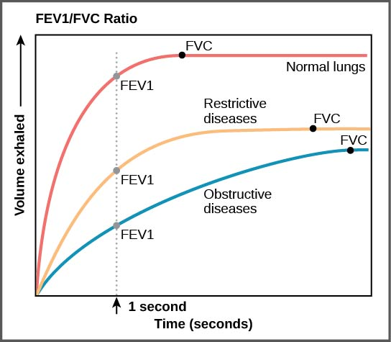
Obstructive lung disorders
Asthma
COPD
Investigations
FVC (Spirometry)

Slide 25
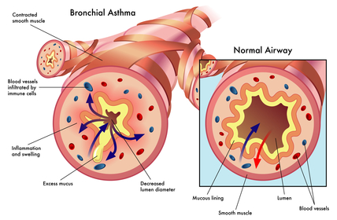
Asthma
Chronic inflammatory disorder of the lungs
Bronchi constricted
May be triggered

Slide 26
Care and management
More deaths than would be „necessary”
Continuous monitoring of vital signs until the patient is stabilised
Safe prescribed oxygen administration (to maintain saturation above 92%)
Safe administration of bronchodilators and steroids (alleviate dyspnoea)
Communication
Regular PEFR measurement (every 15-30 minutes until stabilised) (then 4 times a day)
Sputum collection
Health promotion

Slide 27
Beta-2-agonists
  Salbutamol, terbutaline, salmeterol
Anticholinegics
  Ipratropium bromide
Methylxanthynes
  Theophylline

Slide 28
Corticosteroids
  Beclomethasone, budesonide, fluticasone, -- inhaler
  Prednisolone, hydrocortisone – oral, intravenous

Slide 29
Life threatening asthma
Peak flow 33-50% of predicted or best
Dyspnoea to inability to complete sentences (in one breath)
Tachypnoea (>25/min)
Tachycardia (>110/min)
SpO2<92%
Silent chest
Poor respiratory effort
Cyanosis
Hypotension
Exhaustion
Arrhythmia
Altered consciousness level
PaO2<8kPa

Slide 30
COPD
Chronic obstructive pulmonary disease

Slide 31
COPD
Chronic obstructive pulmonary disease
Signs and symptoms
Reduced FEV1
Dyspnoea
Productive cough
Reduced excercise tolerance
Respiratory failures type 1 and 2
Cor pulmonale

Slide 32
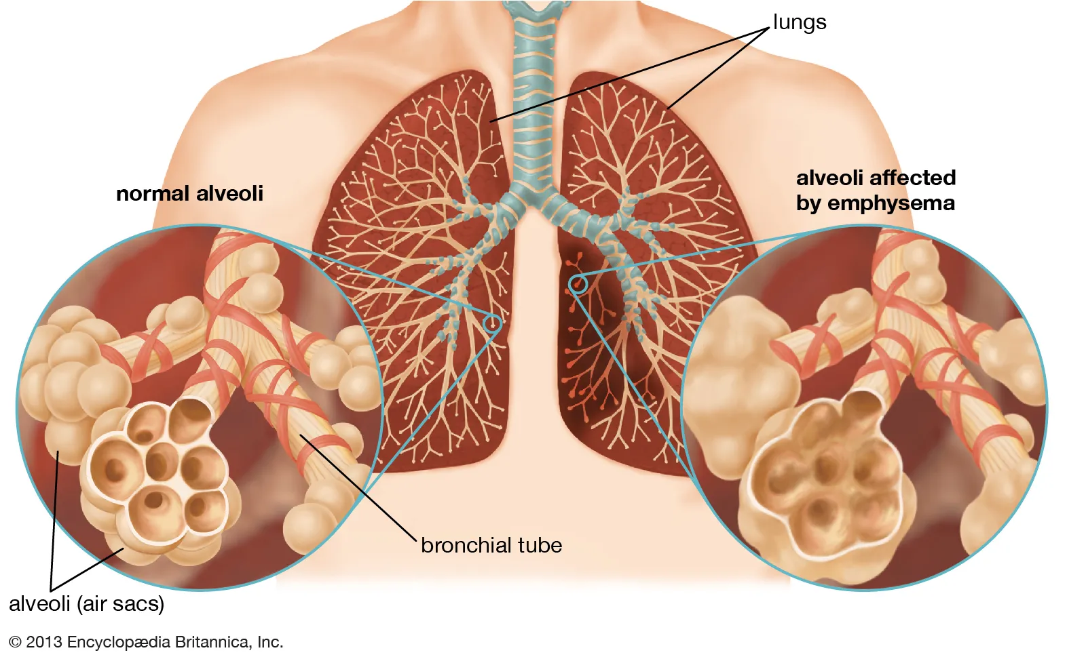
COPD
Emphysema

Slide 33
COPD
Chronic bronchitis
A productive cough lasting for 3 months
In two consecutive years
Other pulmonary and cardiac causes ruled out

Slide 34
COPD
Care and management

Slide 35
Restrictive disorders
Lung cancer
Pleural disorders

