Slide 1
NEUROMUSCULAR DISORDERS

Slide 2
What is a neuromuscular disorder?
A condition affecting one or more of the
following:
  -Muscles
  -Nerves
  -Neuromuscular junction; the area where
  muscle and nerve make connection
  -Motor or sensory cell-body

Slide 3
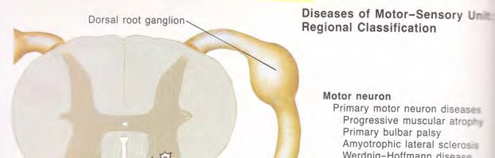
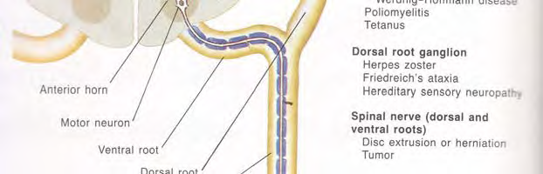
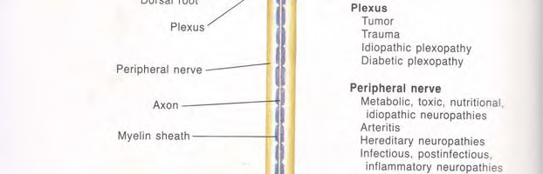
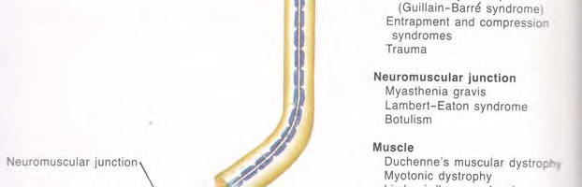
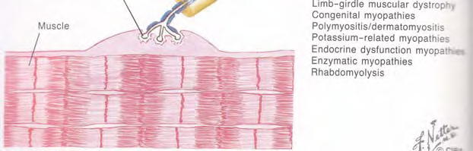

Slide 4
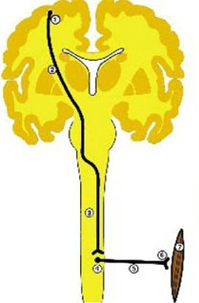
Sites of lesions producing
neuromuscular pathology
Either the upper (1,2,3) or lower motor neurone pathway (4,5),
N-M-J (6) or muscle (7) may be responsible

Slide 5
Sites of lesions producing
neuromuscular pathology
Commonest causes trauma or vascular
accidents (1,2) or demyelination (2,3,4,5)
neuronal degeneration (4), transmission
defects (6) and membrane, fibrillary or metabolic lesions (7).

Slide 6
The motor unit
Neurone
Axon
NMJ
M
Diseases of neuromuscular
transmission
Diseases of
motor neurones
Peripheral
neuropathies
Primary muscle
disease: myopathies

Slide 7
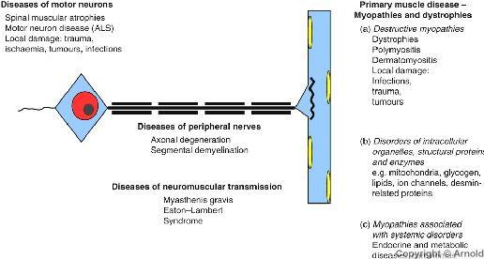

Slide 8
MOTOR NEURON DISEASE

Slide 9
Amyotropic Lateral Sclerosis
~ generalised wasting & fasiculation
~ Bulbar muscle involvement common
~ Associated upper motor neurone
symptoms and signs
~ No sensory symptoms
~ Steadily progressive and fatal

Slide 10
Clinical presentation
Selective loss of LMN from pons, medulla and
spinal cord, together with loss of UMN from the brain
Clinical picture varies depending on whether :
  upper or lower motor neurones are predominantly involved
  Which muscles are most affected
  The rate of cell loss

Slide 11
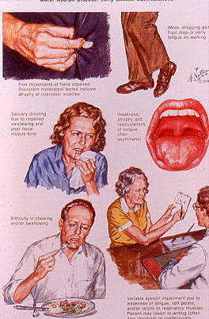

Slide 12
Aetiology of ALS
~ cause unknown
~ 5-10% AD and in familial cases usually starts
10 years earlier than sporadic cases
~ Mutations in the Cu/Zn superoxide dismutase
gene on Ch 21q accounts for 25% of all
familial cases
~ Mutations of the neurofilament heavy
~ Tunisian ALS uncommon AR disease linked to
2q33-q35

Slide 13
The motor unit
Neurone
Axon
NMJ
M
Diseases of neuromuscular
transmission
Diseases of
motor neurones
Peripheral
neuropathies
Primary muscle
disease|: myopathies

Slide 14
Peripheral neuropathy
~ Axonal or demyelinating
~ Neurotransmission most impaired in long
nerves because nerve impulse confronted
by a greater number of demyelinated
segments
~ Therefore symptoms distal in distribution
~ Affects legs and feet more than arm and
hand

Slide 15
Spinal cord
M
Peripheral nerve
myelin
axon
Node of ranvier

Slide 16
Common causes of peripheral neuropathy
Deficiency – Vit B1 alcoholic, Vit B6 in pts taking isoniazid, Vit B12 in patients with PA and bowel disease
Toxic- Alcohol, drugs – isoniazid, vincristine
Metabolic – DM, CRF
Post-infectious – Guillain- Barre syndrome
Collagen vascular – RA, SLE, PA
Hereditary – Charcot- Marie – Tooth disease
Idiopathic – Perhaps up to 50% cases

Slide 17
DIABETIC
POLYNEUROPATHY

Slide 18
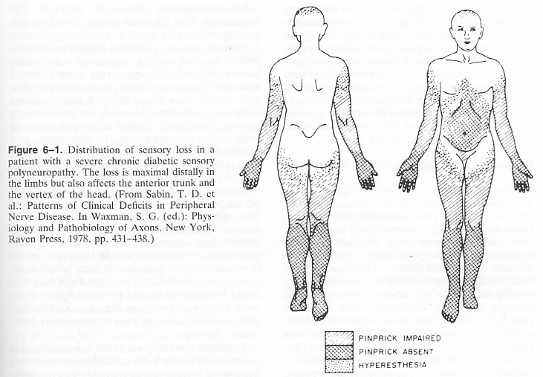

Slide 19
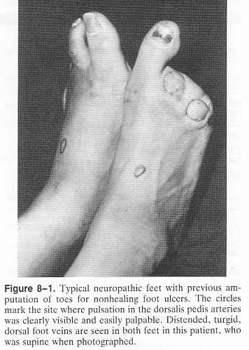

Slide 20
CARPAL TUNNEL
SYNDROME

Slide 21
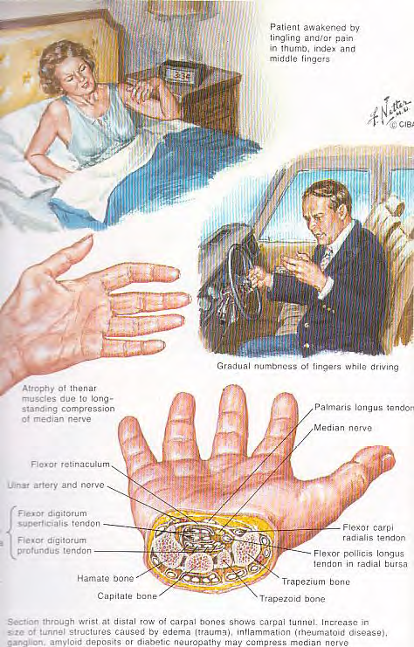

Slide 22
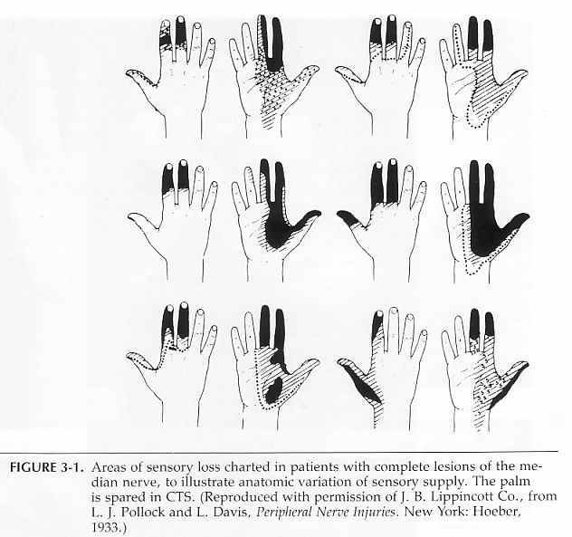

Slide 23
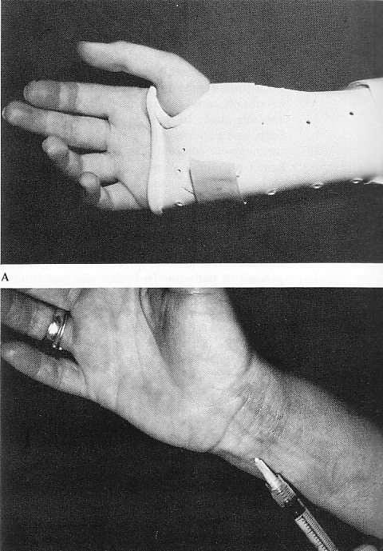

Slide 24
GUILLAIN BARRE SYNDROME

Slide 25
Guillain-Barre syndrome
~ Rapid evolution over several days
~ Life threatening weakness
~ Affects nerve roots as well as peripheral
nerves
~ Occurs within 2 weeks of an infection usually
campylobacter, cytomegalo, EBV
~ Auto-immune response
~ Weakness and sensory symptoms which
worsen daily for 1-2 weeks
~ Demyelinating polyneuropathy and
polyradiculopathy

Slide 26
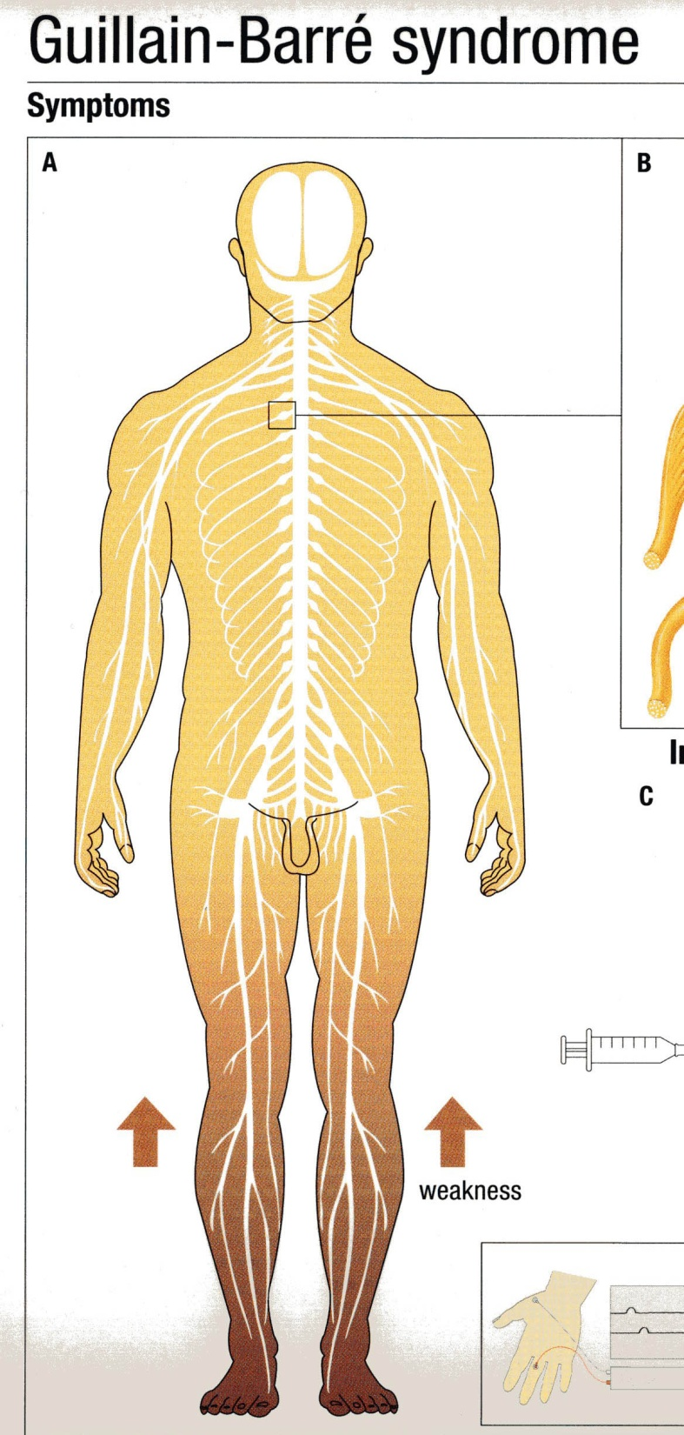
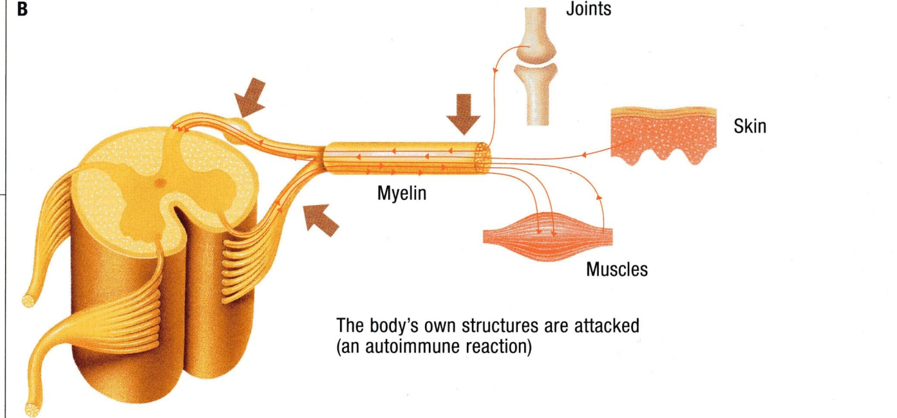
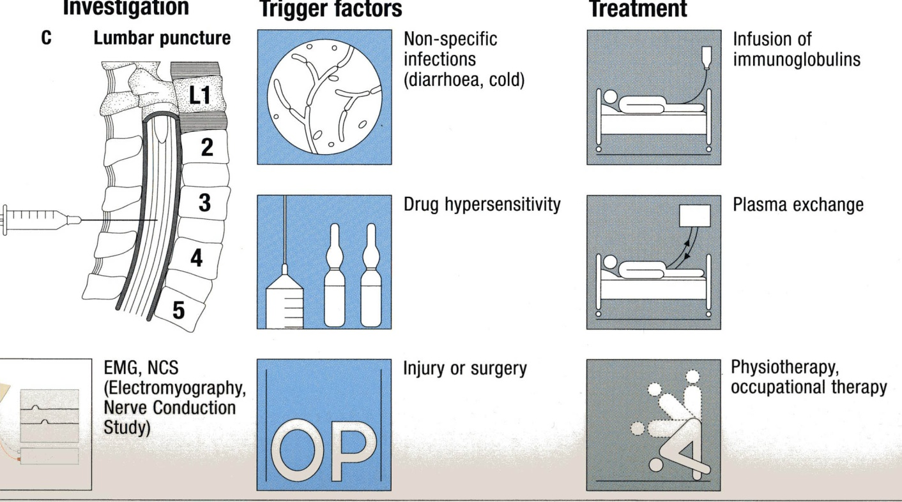

Slide 27
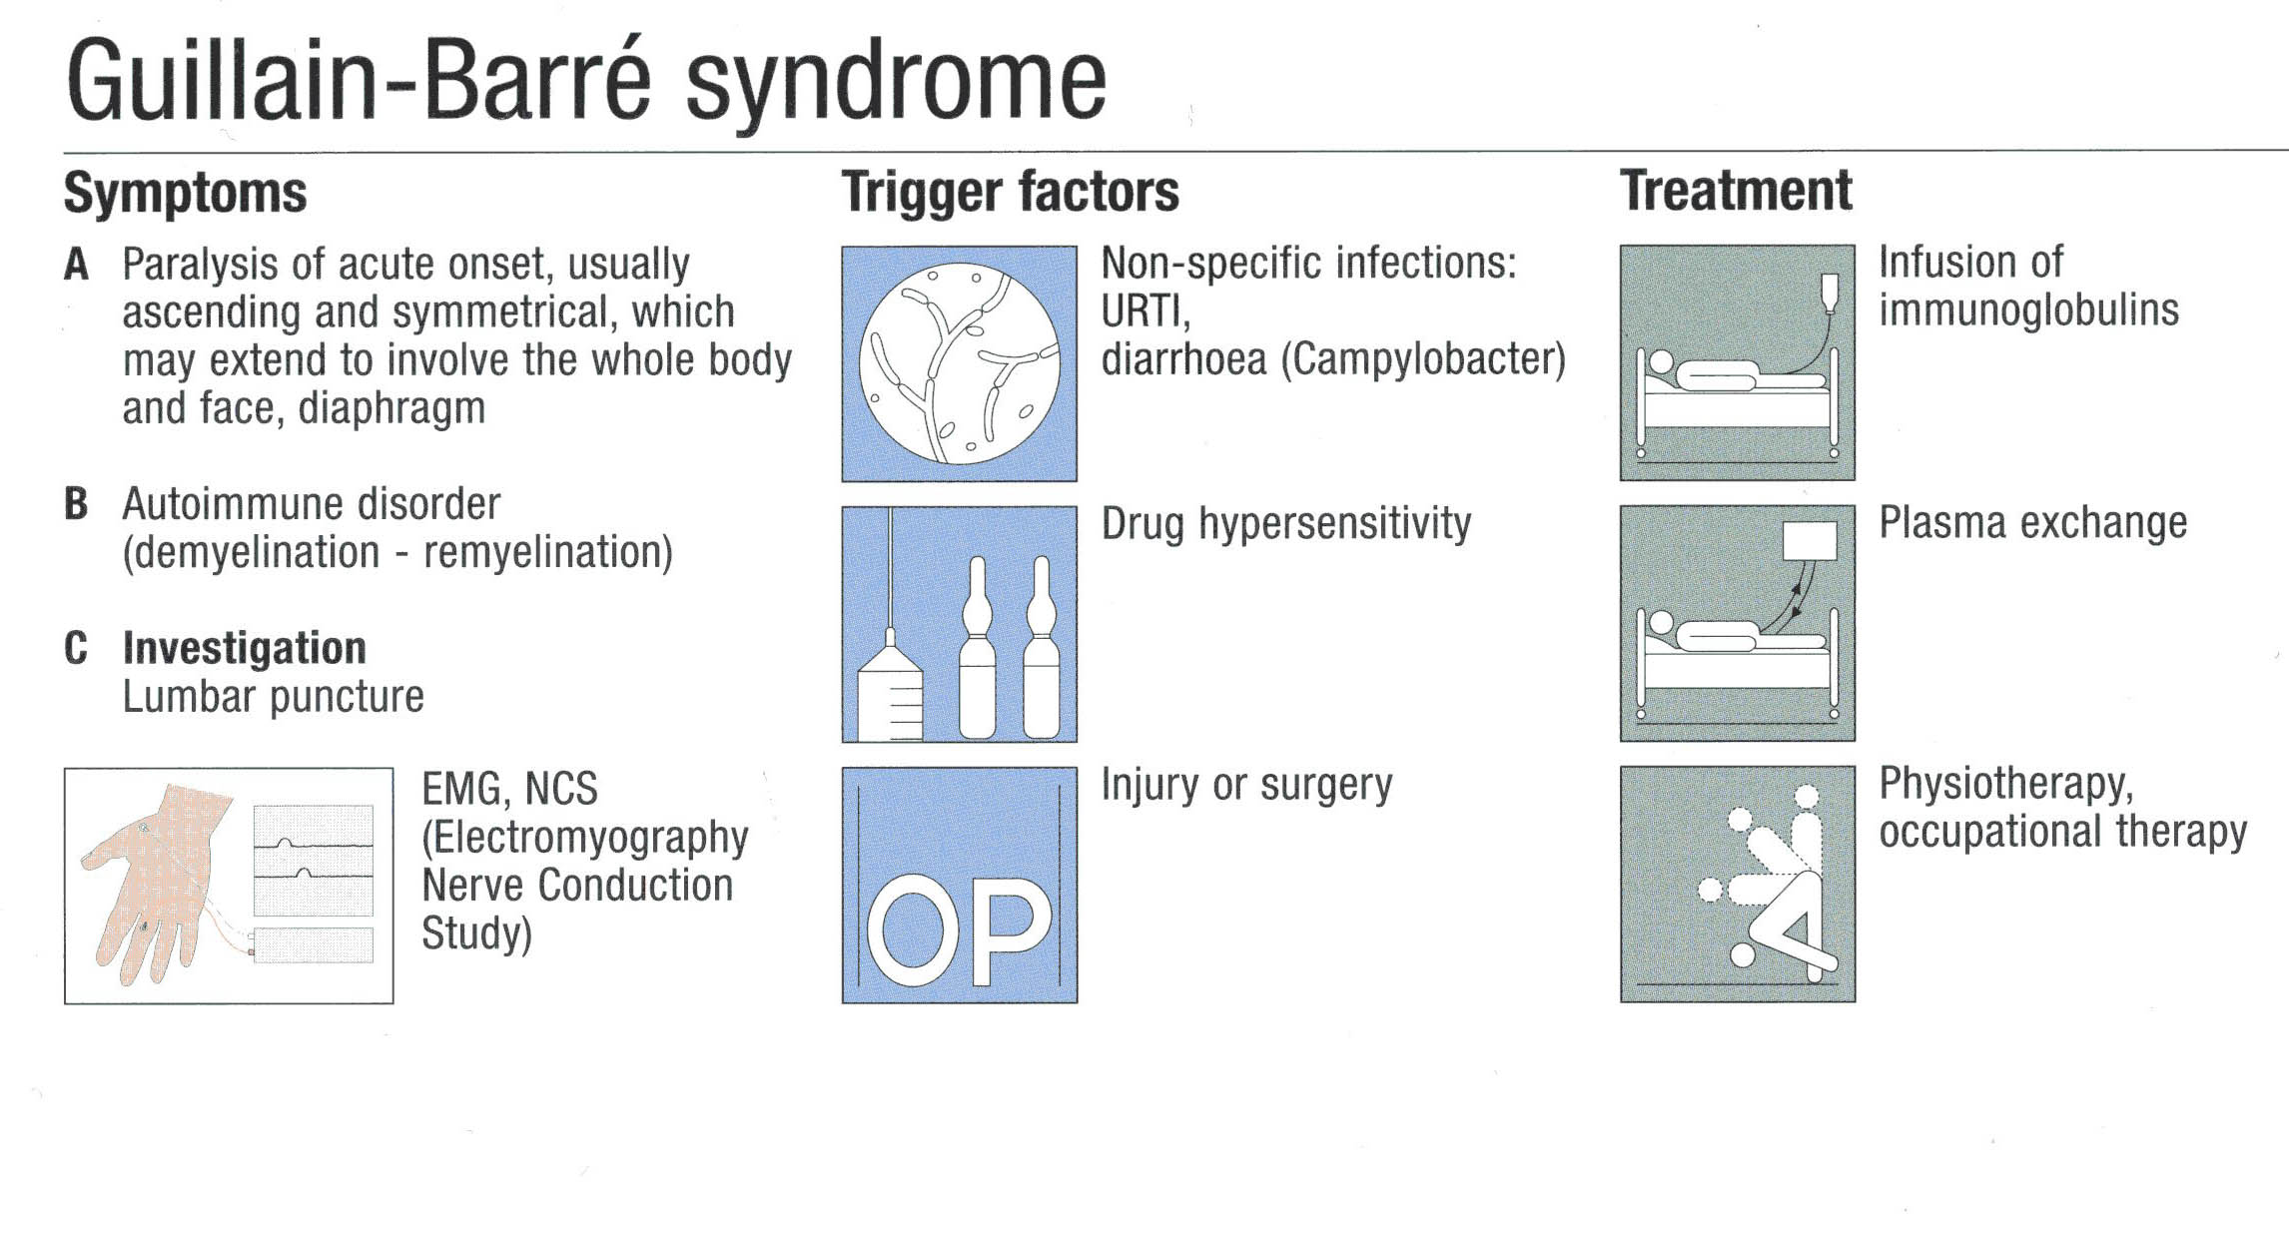

Slide 28
Myasthenia Gravis

Slide 29
Myasthenia Gravis
NMJ
UMN
LMN
M
~ Muscle weakness without wasting
~ Fatiguability
~ Ocular and bulbar muscles commonly involved
~ Responds well to treatment

Slide 30
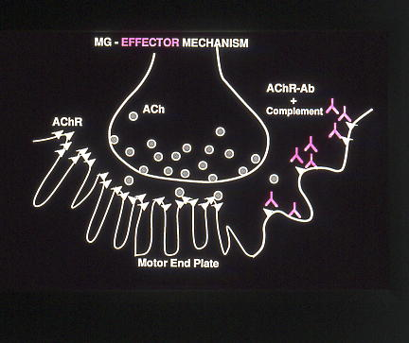

Slide 31
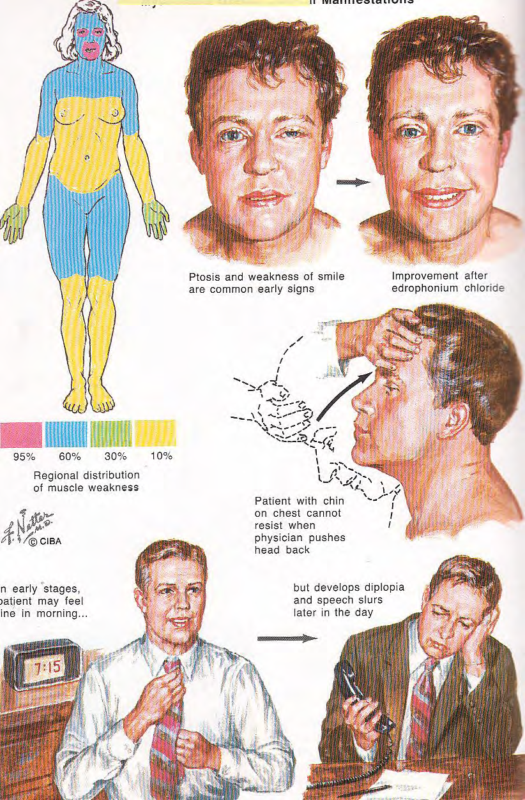

Slide 32
MUSCLE DISEASE

Slide 33
Muscle disease
NMJ
UMN
LMN
M
~ Muscle weakness and wasting – the distribution of which depends
on the type of disease but strong tendency to involve proximal
muscles i.e trunk and limb girdles
~ Various causes

Slide 34
Classification
INHERITED | ACQUIRED
Muscular dystrophies | Endocrinopathies
Myotonic dystrophy | Drug induced
Congenital myopathies | Idiopathic inflammatory myopathy
Metabolic myopathies | Metabolic myopathy
Channelopathies | Myasthenia Gravis /LEMS

Slide 35
MYOPATHY
Muscle weakness
Difficulty climbing stairs
Difficulty holding arms above head for a long period of time
Congenital or acquired, can have
inflammation of the muscles
Need muscle biopsy
Steroids for inflammatory muscle disease

Slide 36
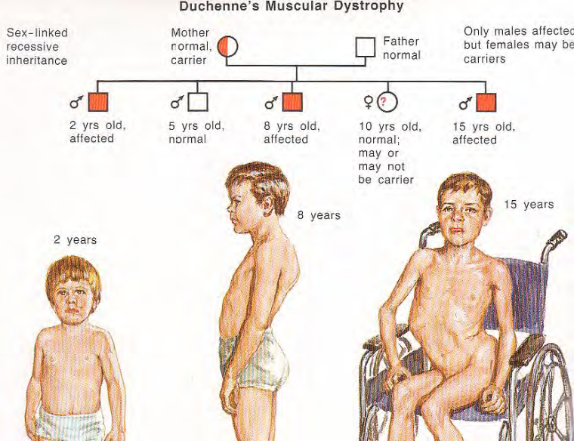
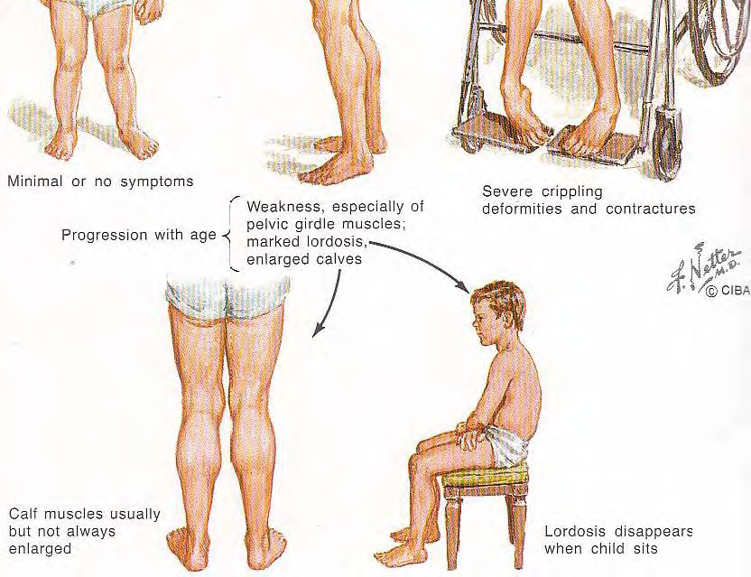
DUCHENNE’S MUSCULAR DYSTROPHY

Slide 37
RADICULOPATHY “Pinched Nerve”
- Weakness
- Numbness, sharp shooting pain
- Abnormal MRI scan, myelogram, EMG/NCV
- Surgical treatment
- Physical therapy
- Medicines

Slide 38
How do we diagnose a neuromuscular disorder?
History & Physical Examination
Laboratory Tests
NCV/EMG
MRI Scans
Muscle biopsy
Nerve biopsy

Slide 39
CONCLUSIONS
UMN – lesions involving the corticospinal tract
LMN – lesions involving brain stem and spinal
cord
MND – may present with UMN and LMN signs
Peripheral neuropathy may be axonal or
demyelinating
Muscle disease may be inherited or acquired

